Slide 1
Khidwai English school
Presented by
Ishrath Mansoora
Class:3rd and 4 th std
Subject :Kannada

Slide 2
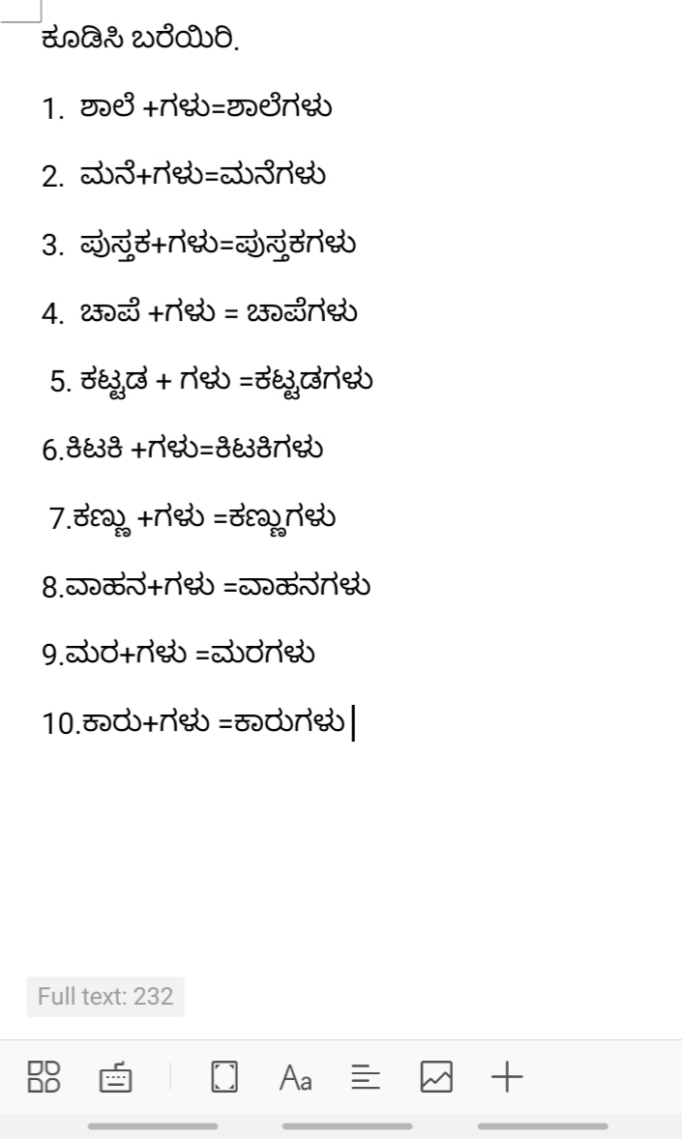

Slide 3
ವಂದನೆಗಳು

