Slide 1
Continents,Oceans and Seas

Slide 2
Continents
The earth is divided into 2 parts one is land and onother one one is water.
1.The area covered by land only 29% of the earth is called Continents.
There are 7 Continents in the World.
1.Asia 5.Antarctica
2.Africa 6.Europe
3.North America 7.Australia
4.South America

Slide 3
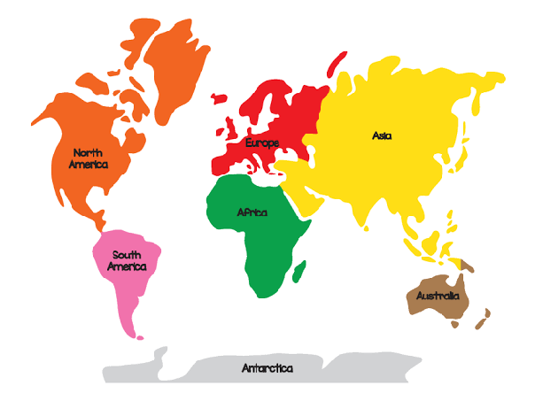
7 Continents

Slide 4
OCEANS
The area covered by water 71%of the earth is called Oceans.
1.There are 5 Oceans in the World.
*The PacificOcean
*The Atlantic Ocean
*The Indian Ocean
*The Arctic Ocean
*The Antarctic Ocean

Slide 5
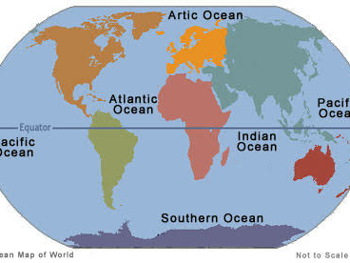
Oceans

