Slide 1
Andhra Pradesh and Telangana

Slide 2
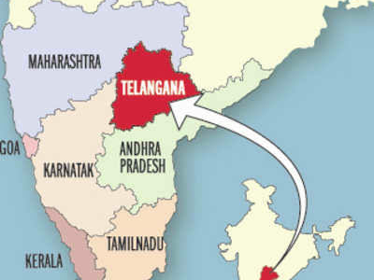
Map of Andhra Pradesh and Telangana

Slide 3
Andhra Pradesh and Telangana are located on Southern part of India.
Before 2014 Telangana was the part of Andhra Pradesh but in 2nd june 2014 Telangana separated from Andhra Pradesh as a new State of India.
3.Harikatha was originated from Andhra....
4.Karnataka is one of the neighbouring state of Andhra Pradesh.

